Slide 1

Arduino Christmas
…because Santa is a Maker!

Slide 2

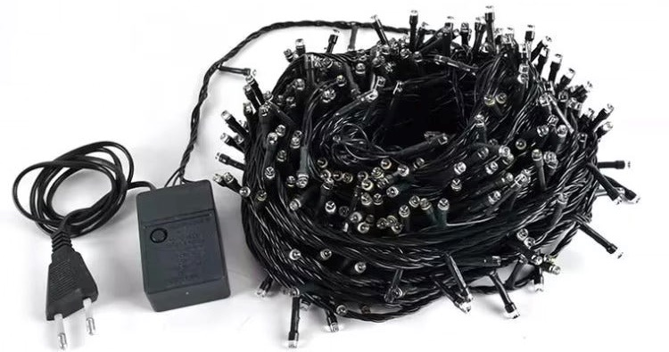
What are we going to build?

Slide 3
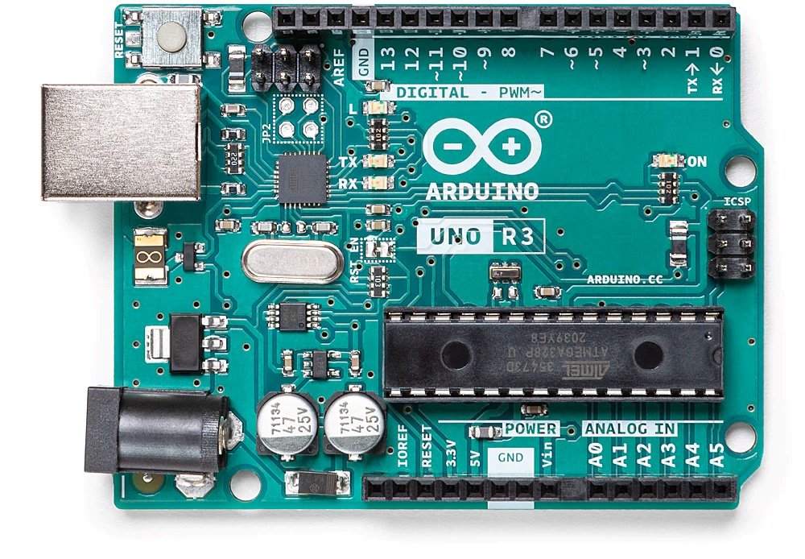
Arduino Uno
GND (ground, 0V)
Digital inputs and outputs
Reset button
ATmega328P microcontroller
USB (uploading programs + supply voltage )

Slide 4
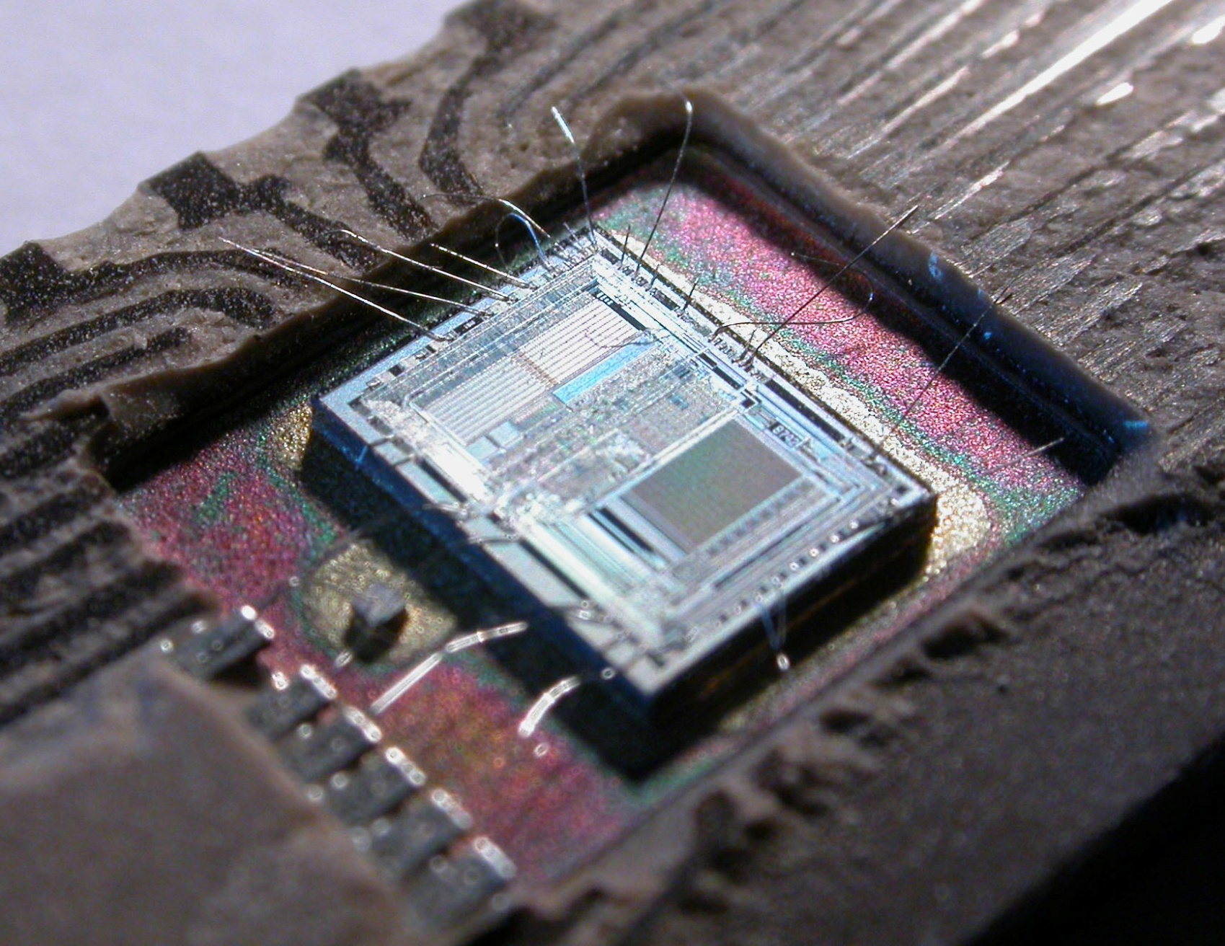
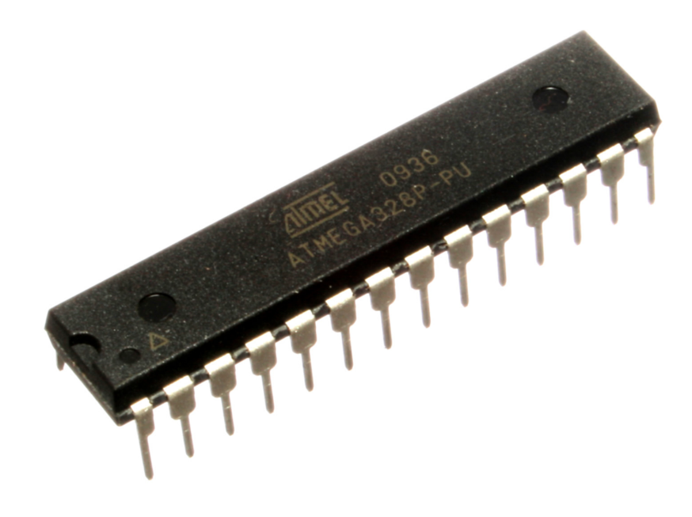
Microcontroller
Mikrokontrollerek

Slide 5
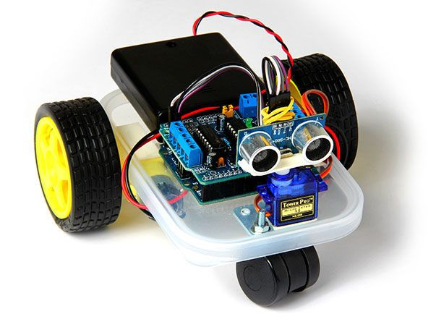
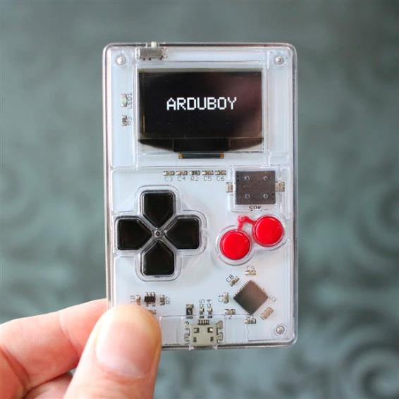
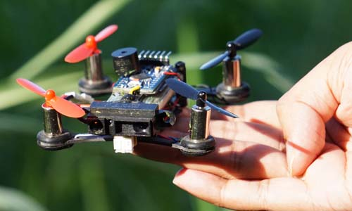
Arduino Uno
More than 10 million boards sold since 2010
ATtiny328 microcontroller:
Speed: 16 MHz
Storage: 32 KB flash
RAM: 2 KB

Slide 6
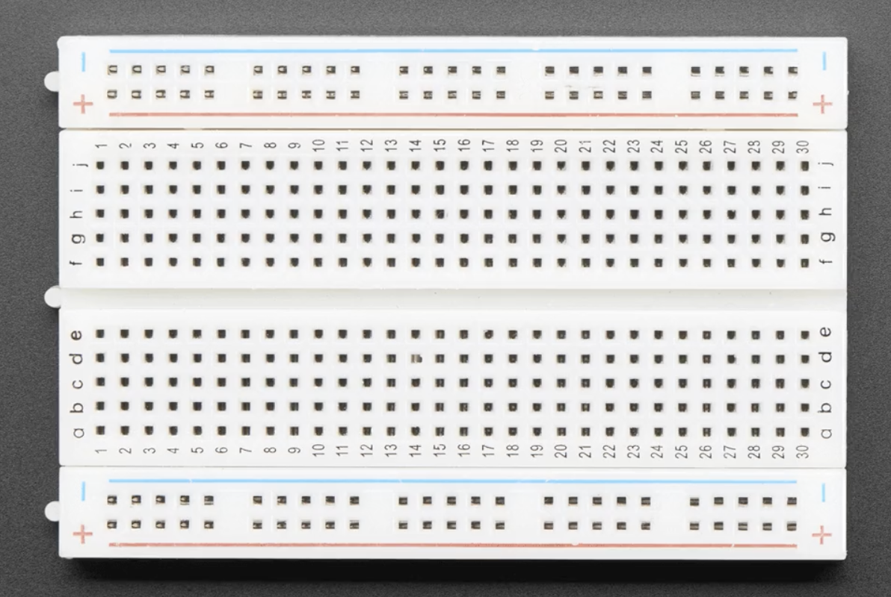
Breadboard

Slide 7
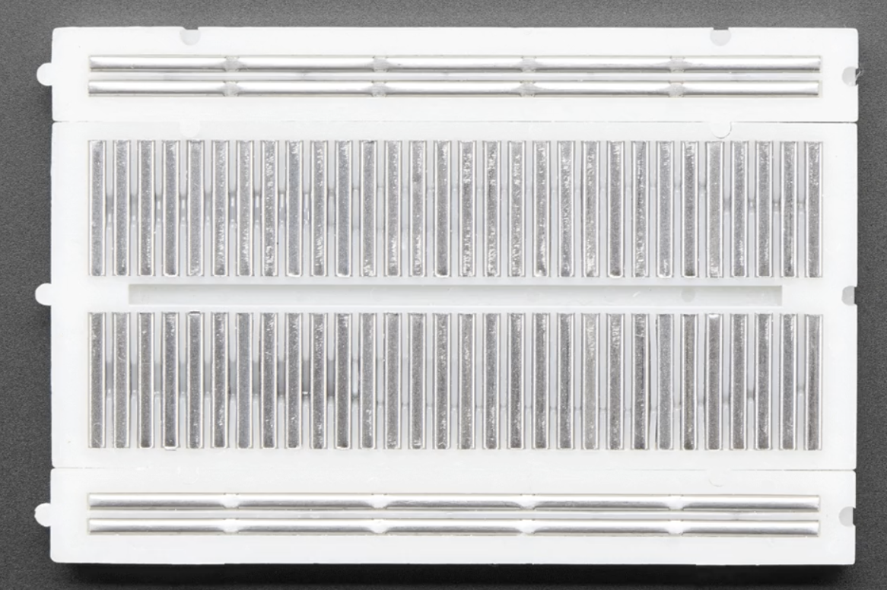
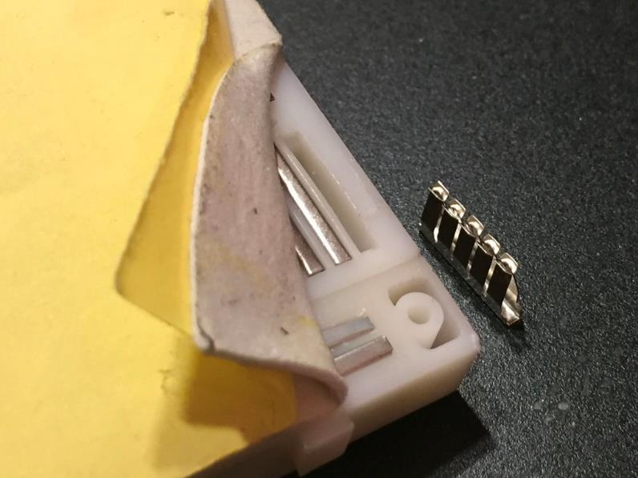
Breadboard

Slide 8
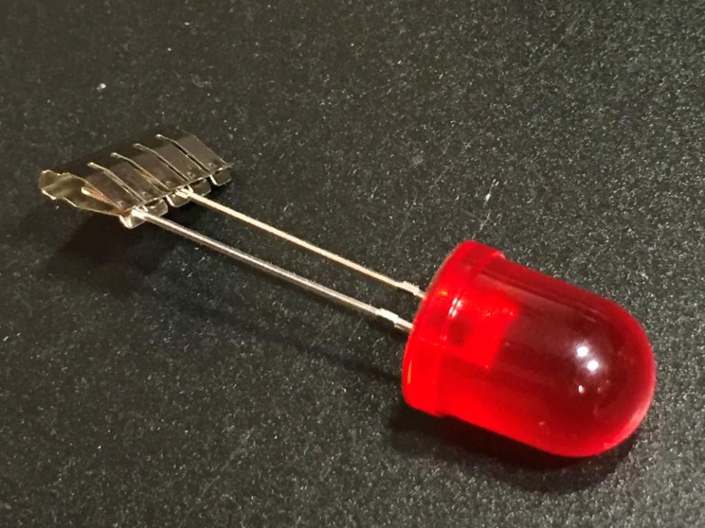
Breadboard

Slide 9

Sound

Slide 10
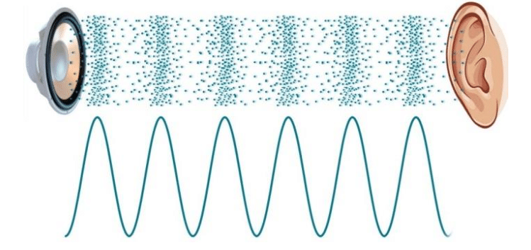
Sound
Periodic changes in air pressure, sensed by our ears as sounds
Periodic contraction and release of the speaker membrane
Magnetic speakers: turning an electromagnet on and off to move the membrane
Piezo-electronic speakers: the membrane is made of material deforming under electic voltage

Slide 11

Sound ranges
Infrasonic
Human hearing
Ultrasonic
> 20.000 Hz
20 Hz … 20.000 Hz
< 20 Hz

Slide 12
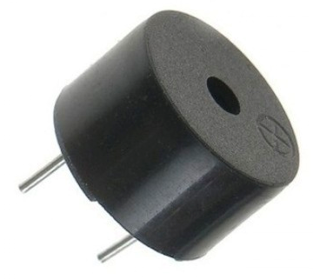
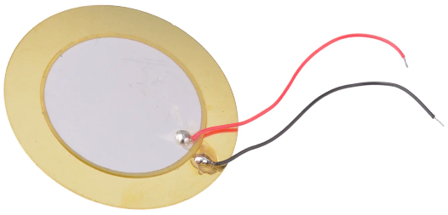
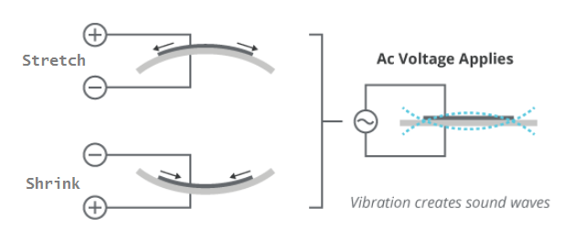
Piezo „buzzer”
Simple, cheap
Higher, sharper sounds are louder
Typically: 1 .. 7 KHz tartomány
Lower frequencies produce „clicking” sounds (e.g. < 65 Hz)

Slide 13
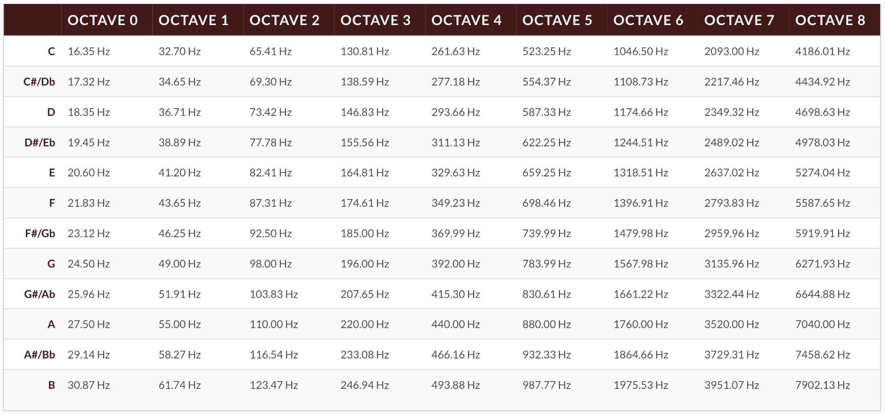
the recognizable sounds produced by our piezo speaker
PIANO
volume

Slide 14
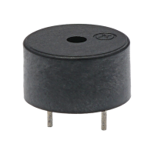
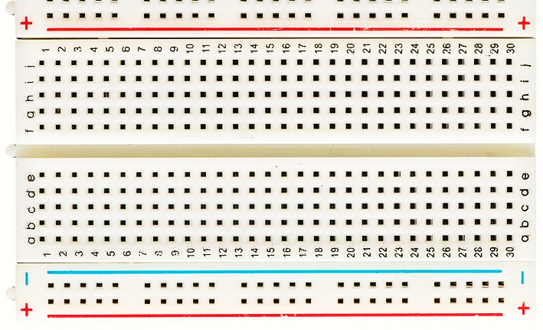
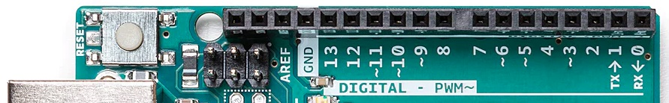
The music is restarted when pushing the „reset” button
–
+
reset
39 Ω

Slide 15

LEDs

Slide 16
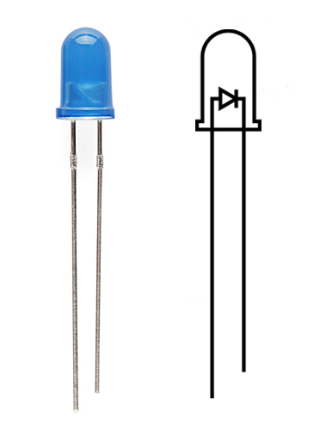

LED
“Light Emitter Diode”
Can only be connected in one direction!
+
–
+
–

Slide 17
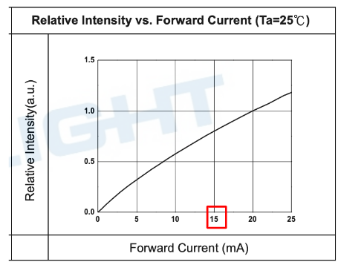
LED
“Light Emitter Diode”
Can only be connected in one direction!
Light intensity depends on the strength of the current flowing through it (e.g. I_{LED} = 15 mA), which can be controlled by the resistor value.
Example from a datasheet of a 5mm diameter red LED. (333-2SDRD/S530-A3 )

Slide 18

The LED turning on/off based on the rhythm
–
+
+
–
220 Ω
reset
39 Ω

Slide 19

The LEDs are flashing alternately to the rhythm
–
+
+
+
–
–
220 Ω
220 Ω
reset
39 Ω

Slide 20

Buttons

Slide 21
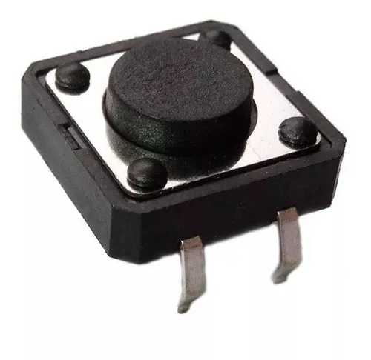
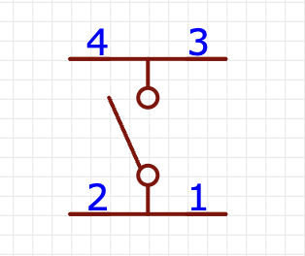
Push buttons
Connecting two points in the circuit, when pressed
Or two-two points, if the push button has four pins
3
1

Slide 22
Playing the tune only when the button is pushed
–
+
+
+
–
–
220 Ω
220 Ω
reset
39 Ω

Slide 23
Reading digital inputs
logical 0
logical 1
- 0,5 V
0 V
1,5 V
3 V
5 V
5,5 V
The microcontroller is sensing the logical 0 / 1 values on its digital inputs
The pin is „floating”, if nothing is connected
Rapidly and randomly changing it’s value
Under 30% voltage, we read 0
Above 60% voltage, we read 0

Slide 24
Start / Stop button, read by the code
–
+
+
+
–
–
220 Ω
220 Ω
39 Ω

Slide 25

Further links
Arduino: https://www.arduino.cc/
Source code: https://github.com/symat/arduino_christmas

